Slide 1
Capstone Projects

Slide 2
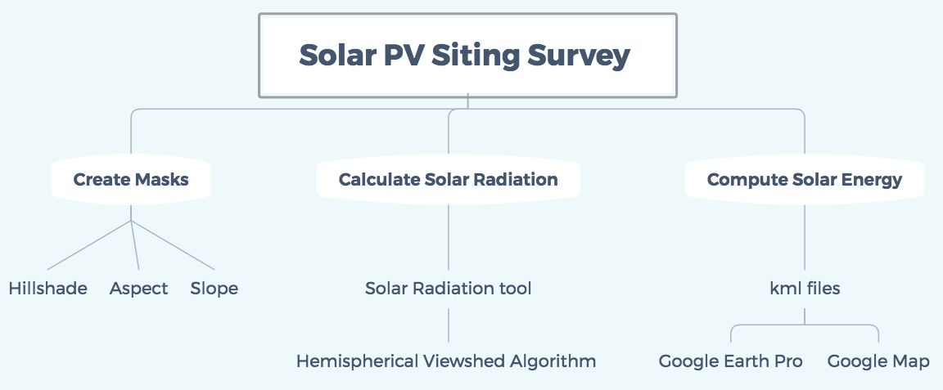
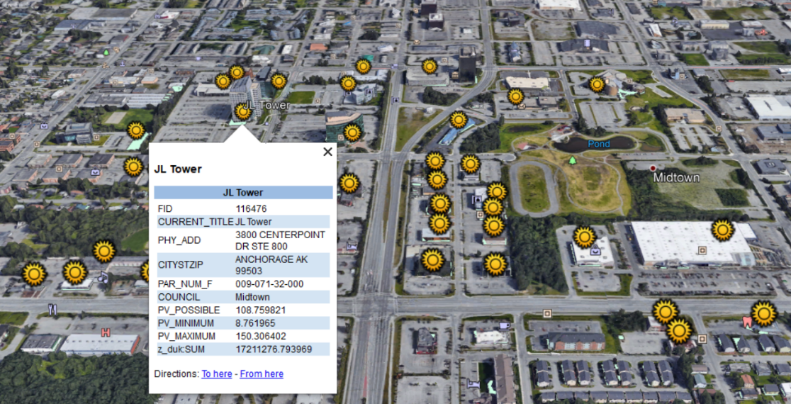
Solar PV Siting Survey for Anchorage, Alaska
Sponsor: Erin Whitney (Alaska Center for Energy and Power)
Team Members: Jingtian Zhang, Cheng Zeng, Yuening Wang
Objective:
This project identifies potential solar sites to install solar panels on rooftops and parking lots structures in Anchorage, Alaska. Solar energy calculation model consists of three steps:creating masks, calculating solar radiation and calculating solar energy. It is based packages of Arcgis Desktop. The input is Light Detection and Ranging (LiDAR) data, and the output is .kml files, which can be displayed in Google Earth Pro and Google Map. Also, this project takes HVAC system, vents and pipes on the rooftop, parking lots on the ground into consideration, so that it makes solar calculation more accurate. Eventually, this model might apply to other cities with similar situation.
Figure 1. Flowchart of Model Building
Figure 2.Example of sites displayed in Google Earth Pro

